Slide 1
Web Development
Launched by KiUCPC
Prepared By: Mahadi Hassan
Instructor:
Mahadi Hassan – CSE 1st Batch
Kobir Hossen – CSE 2nd Batch

Slide 2
Web Development
What is Web Development ?

Slide 3
Web Development
Web development is the process of designing, building, and maintaining websites and web applications that run on the internet

Slide 4
Websites and Web Applications
What is Web actually?
World Wide Web (WWW): as short ,Web, it is an information system that enables content sharing over the internet.
What is Web site?
A collection of related web pages located under a single domain name, typically produced by a single person or organization.

Slide 5
Websites and Web Applications ( Continue)
What is web page?
A web page is a single page on the internet where we can:
Display text,
Show images,
Play videos,
And organize content nicely.

Slide 6
Websites and Web Applications ( Continue)
What is web Applications? A web application is a computer program that uses web browsers and web technology to perform tasks over the internet.
💡 Examples of Web Applications:
Gmail – to send emails
Google Docs – to write documents
YouTube – to watch videos
Facebook – to connect and chat

Slide 7
Back To Web Development
What Will We Do Here?
We will develop a complete website from scratch to finish, so that you can learn:
✅ How to start a web development project
✅ How to write code (HTML, CSS, JavaScript) for web page
✅ How to build real, working websites
✅ Step-by-step website creation process
✅ Basic design and deployment

Slide 8
Why need Web Development ?
To build websites and apps that make life easier and faster
To access information and services anytime, anywhere
To help businesses reach customers online
To communicate and work remotely
To create tools for education, shopping, banking, and more
To solve real-world problems with technology

Slide 9
Part Of Web Development
Web Development can be classified into two ways:
Frontend Development: The part of a website that the user interacts directly is termed as front end. It is also referred to as the ‘client side’ of the application.
Backend Development: Backend is the server side of a website. It is the part of the website that users cannot see and interact. It is the portion of software that does not come in direct contact with the users. It is used to store and arrange data.

Slide 10
Front End
Our University Website:
https://kiu.ac.bd/

Slide 11
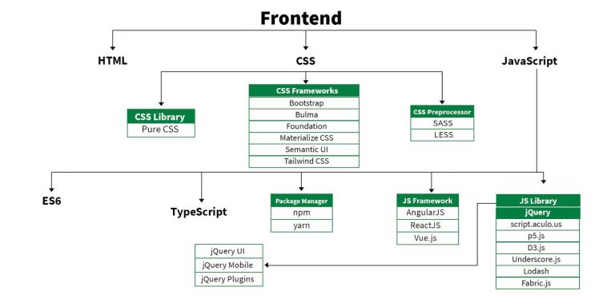
Front End Technologies

Slide 12
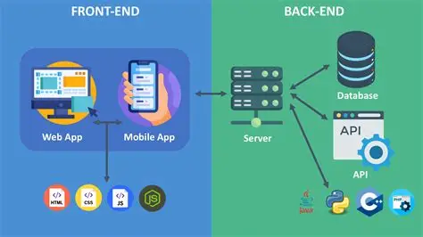
Back End

Slide 13
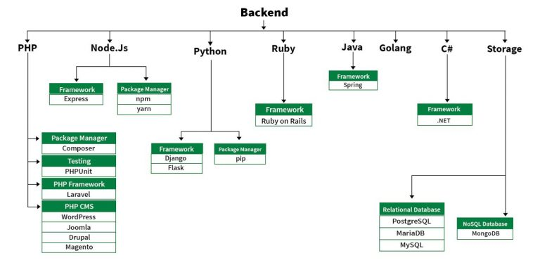
Back End Technologies

Slide 14
Road Map of Our Course
HTML
CSS
JavaScript
PHP
DBMS Connection with Project
Route
Laravel
Database
Authentication
API

Slide 15
Our Road map for Web Development
📅 Week 1 & 2: HTML
Introduction to HTML
Basic tags and structure
Forms and input types
Semantic HTML
Media (images, videos, audio)
Tables and lists
Project: Build a static portfolio site

Slide 16
Our Road map for Web Development
📅 Week 3: CSS
CSS Syntax and Selectors
Box Model
Flexbox and Grid
Responsive Design (Media Queries)
CSS Animations & Transitions
Project: Style the portfolio website

Slide 17
Our Road map for Web Development
📅 Week 4: JavaScript
JS Basics (Variables, Data types, Operators)
Functions and Control Flow
DOM Manipulation
Events and Event Listeners
Basic Form Validation
Project: Interactive to-do list or calculator

Slide 18
Our Road map for Web Development
📅 Week 5: Basic PHP
PHP Syntax and Variables
Control Structures
Functions
Form Handling with PHP
Working with $_GET and $_POST
Project: Contact form or simple login system

Slide 19
Our Road map for Web Development
📅 Week 6: Database (MySQL)
Introduction to Relational Databases
MySQL Basics: CRUD Operations
phpMyAdmin Usage
Connecting PHP to MySQL
Project: User registration system with database

Slide 20
Our Road map for Web Development
📅 Week 7: PHP Framework (Laravel / etc.)
Environment setup (Laravel/Other)
MVC Architecture
Routing
Views (Blade templates if Laravel)
Database Migrations

Slide 21
Our Road map for Web Development
📅 Week 8: Database & Advanced Backend
Eloquent ORM (Laravel)
Authentication (Login, Register)
Middleware & Route Protection
Data Validation

Slide 22
Our Road map for Web Development
📅 Week 9: API & Final Touches
RESTful APIs Basics
API routes in PHP framework
Using Postman to test APIs
Consuming APIs in frontend (fetch/AJAX)
Final Project Integration

Slide 23
Any Question?

